Slide 1



TEAM
HAZEL
IIM
UDAIPUR
Tushar Singh
Deepanshu Rawat
Intro

Slide 2
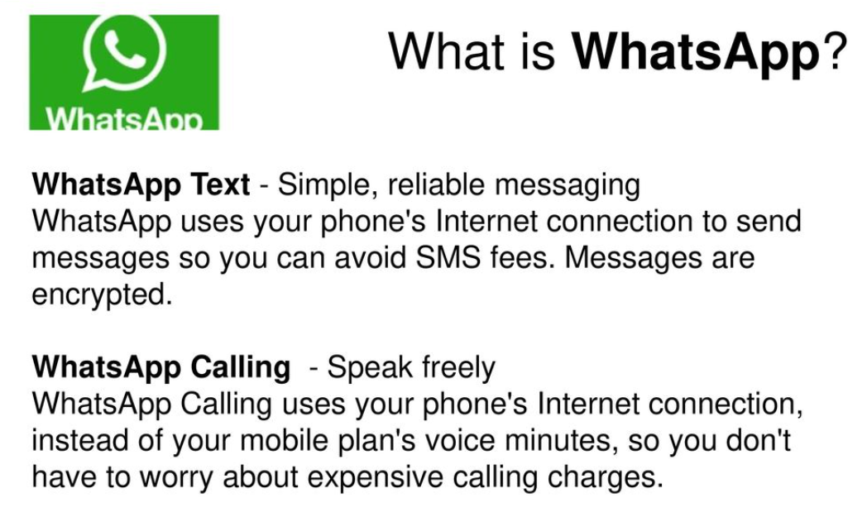
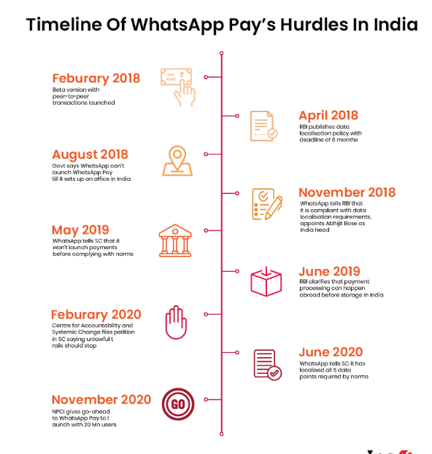
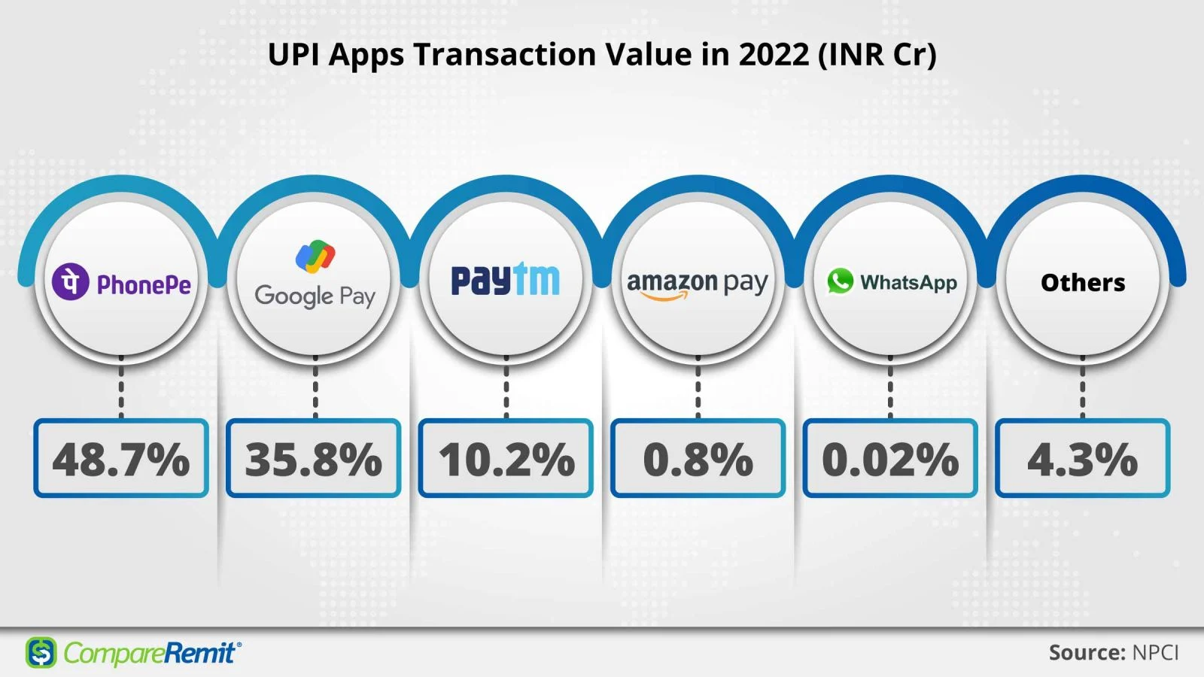
Overview
Revenue is vanity, profit is sanity, but cash is king. - Alan Miltz
INDUSTRY OVERVIEW
PROBLEM STATEMENT
Despite its massive user base and initial promise, WhatsApp Payments has struggled to gain significant traction in India. As a Product Manager for WhatsApp Payments, we must analyze the potential reasons for this limited success and propose strategic changes that could have propelled WhatsApp Payments towards greater adoption.
E-Commerce
Digital India Cam.
Covid 19
Food Delivery
E-Commerce
Travel/ Mobility
Healthcare
Retail
Education
Leading countries in the world with the highest number of contactless card transactions as of 2022 (in billions)
Volume of digital transactions in India in financial year 2024, by mode (in billions)
Value of credit transfers across India from financial year 2018 to 2023, by mode of payment (in trillion Indian rupees)

Slide 3
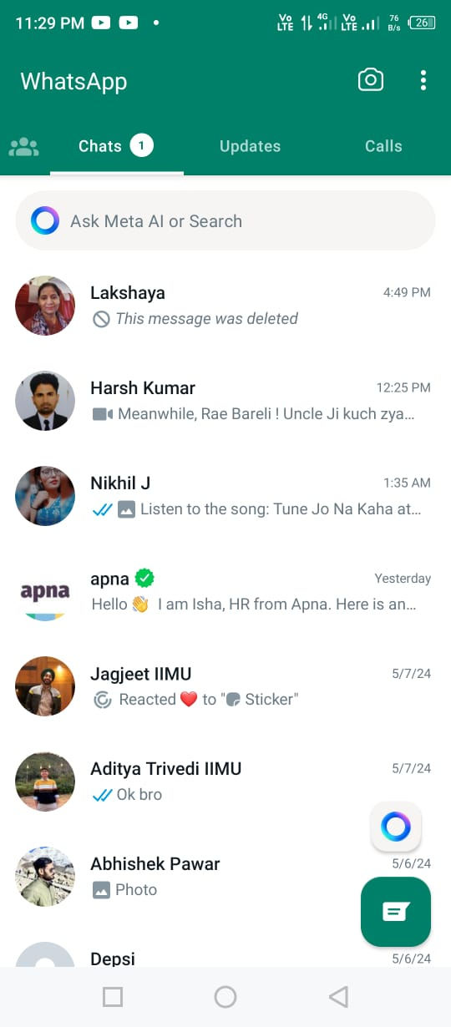

Issues VS Solutions
Concerns with UX
Scanning Option
Expense Tracking
When you open your WhatsApp, you don’t see any payments option available.
This leading into of many consumer not being aware of this feature.
You can pay the merchant through UPI ID or UPI Number, but there is no scanning option available.
Checking your payment history and settings related to payments are difficult to track due to its UI concerns.
Launch Wallet
Separate Option For Payment
A separate tab for Payments
Split Payments between group.
Integration With CRM

Slide 4


Issues VS Solutions
Security and privacy
Users are skeptical of using WhatsApp Payments because they don’t trust Meta. They are concerned about WhatsApp sharing data with other Meta platforms or selling their data to third parties.
Also, WhatsApp follows pathetic refund policy, and do not take any responsibility for transactions.
“To get a refund, you should reach out to the business directly.
WhatsApp also doesn't provide any customer support for payments made to businesses on WhatsApp or the WhatsApp Business app in India.
”
WhatsApp should consider outsourcing customer service for its payment service to ensure efficient and effective support for users.
Use AI chatbots as a feature on the payments tab, to resolve first level queries of users and lodge complaints for higher level, which then become one of the chat messages.
Transparency: Communicate data privacy practices used by WhatsApp Payments and emphasize robust security measures.

Slide 5
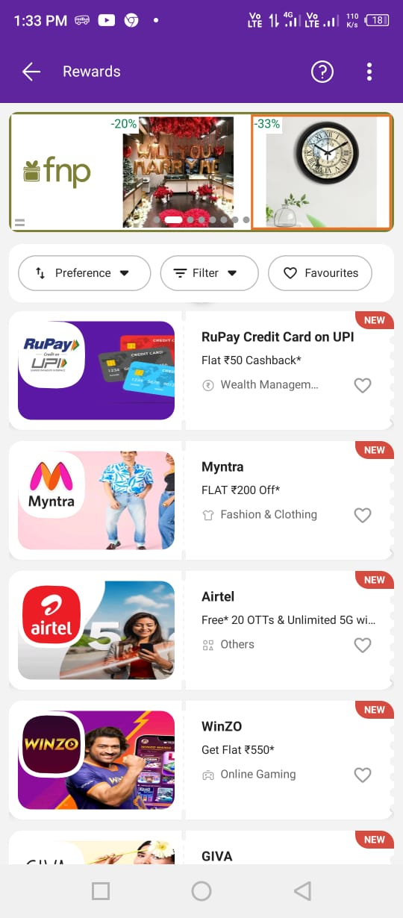
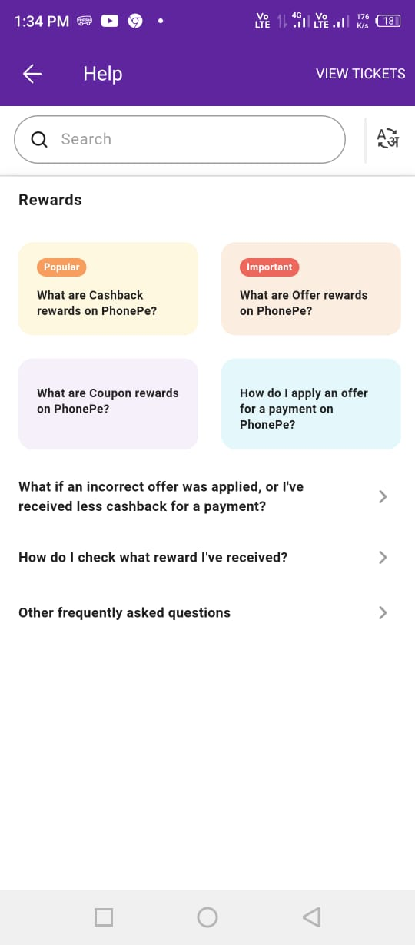

Issues VS Solutions
Lack of incentives
Users lack motivation to switch to WhatsApp Payments from other familiar platforms because there’s no reward for that.
We believe switching cost is moderate in this industry, if you are a reputed player offering potential advantages, people will switch their platform for that advantage.
Welcome offers and cashback rewards: Offer incentives like cashback or discounts for first-time users.
Partnerships with merchants: Partner with local merchants and online retailers to offer exclusive deals and discounts when using WhatsApp Payments.
Peer recommendations: Incentivize existing users to recommend their friends, leveraging the network effect of WhatsApp.
Integrate it with Channels.

Slide 6


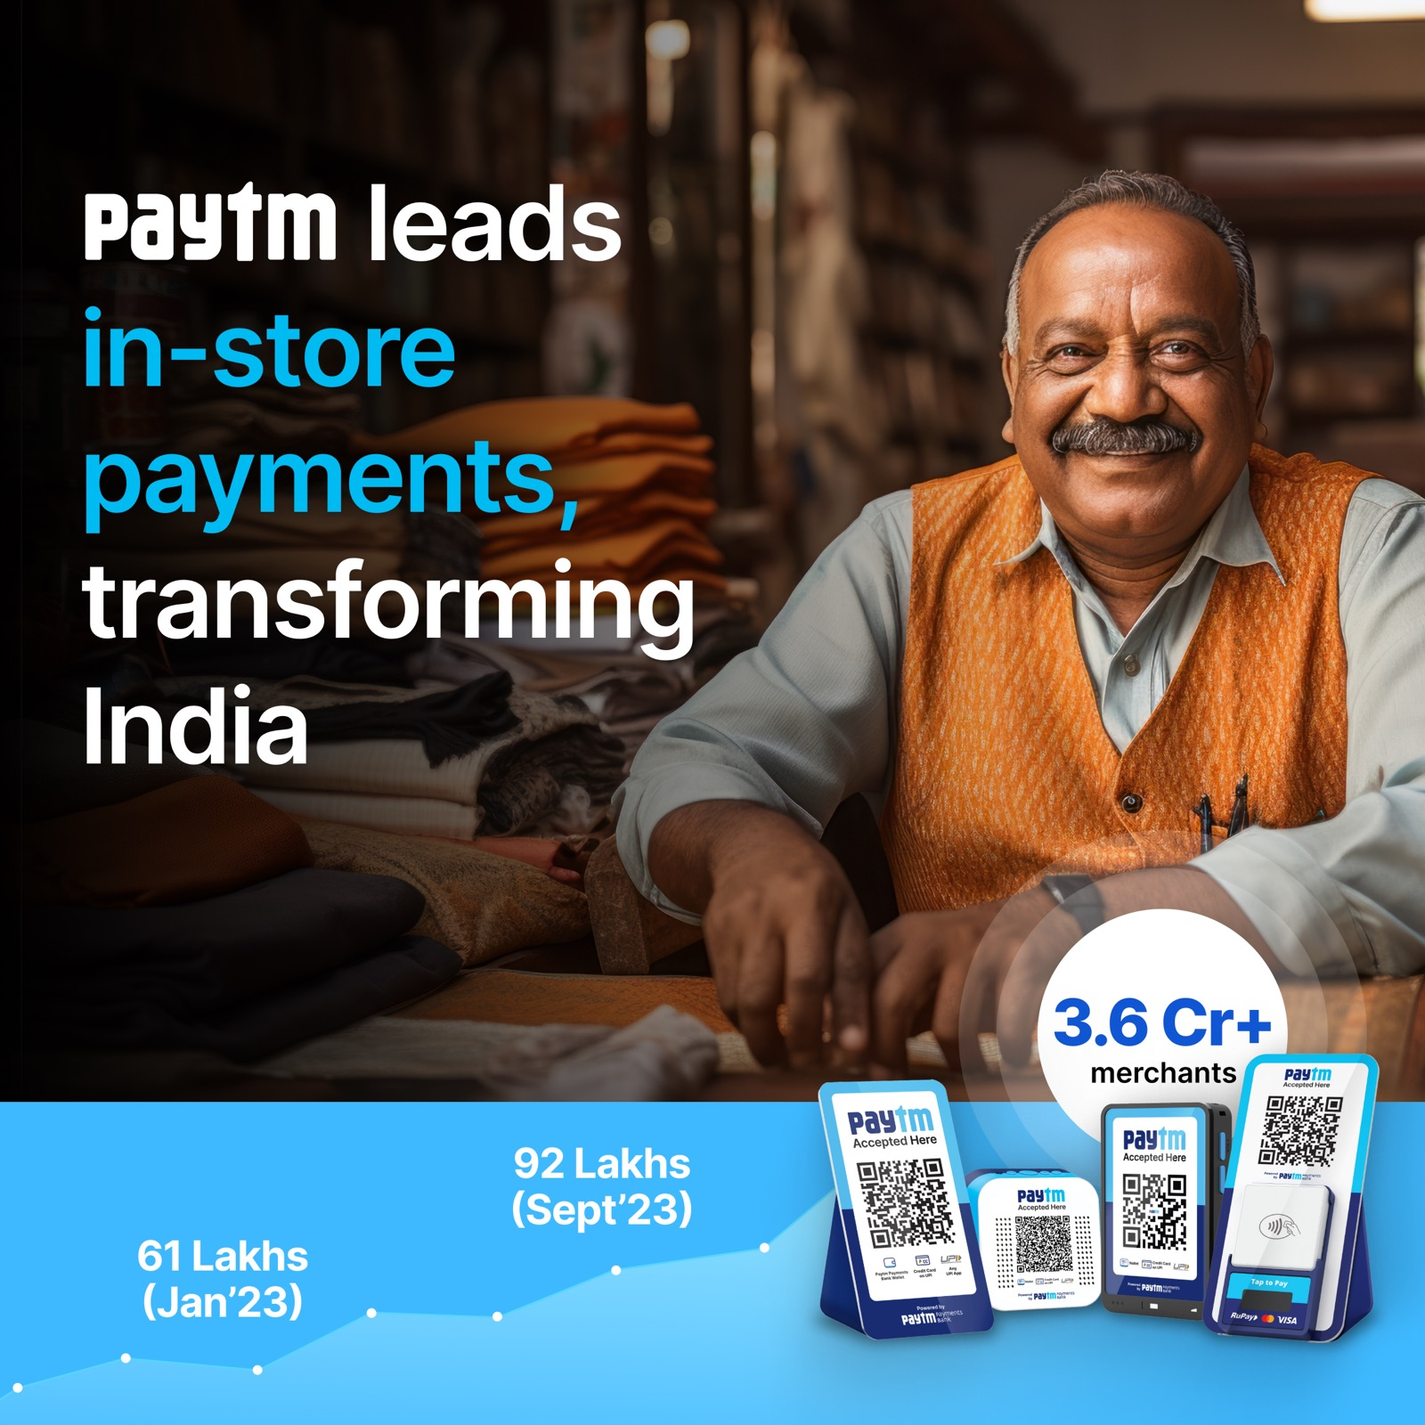

Issues VS Solutions
Limited awareness
Enhance User Education and Awareness
In-app tutorials: Show interactive tutorials and guides explaining the benefits and functionalities of WhatsApp Payments.
Targeted campaigns: Run targeted campaigns within the app, highlighting specific use cases like splitting bills or easy payments.
Leverage Meta Platforms for running adds.
Collaboration with influencers: Partner with financial influencers to showcase multiple use cases and benefits of using WhatsApp Payments
Many users are unaware of the feature or its functionalities. Also, there’s no direct payment option on the home screen of WhatsApp for users to scan and pay on the go

